Slide 1


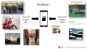
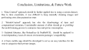
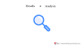
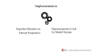

EPIC: Egyptian Personal Images Classifier
By: Ashraf Adel - 196280
Supervised By:
Associate Prof. Nahla Barakat
Questions
Problem Statement
EPIC
Conclusion , Limitation, & Future Work
Proposed Solution & Methodologies
Results & Analysis
Implementation

Slide 2
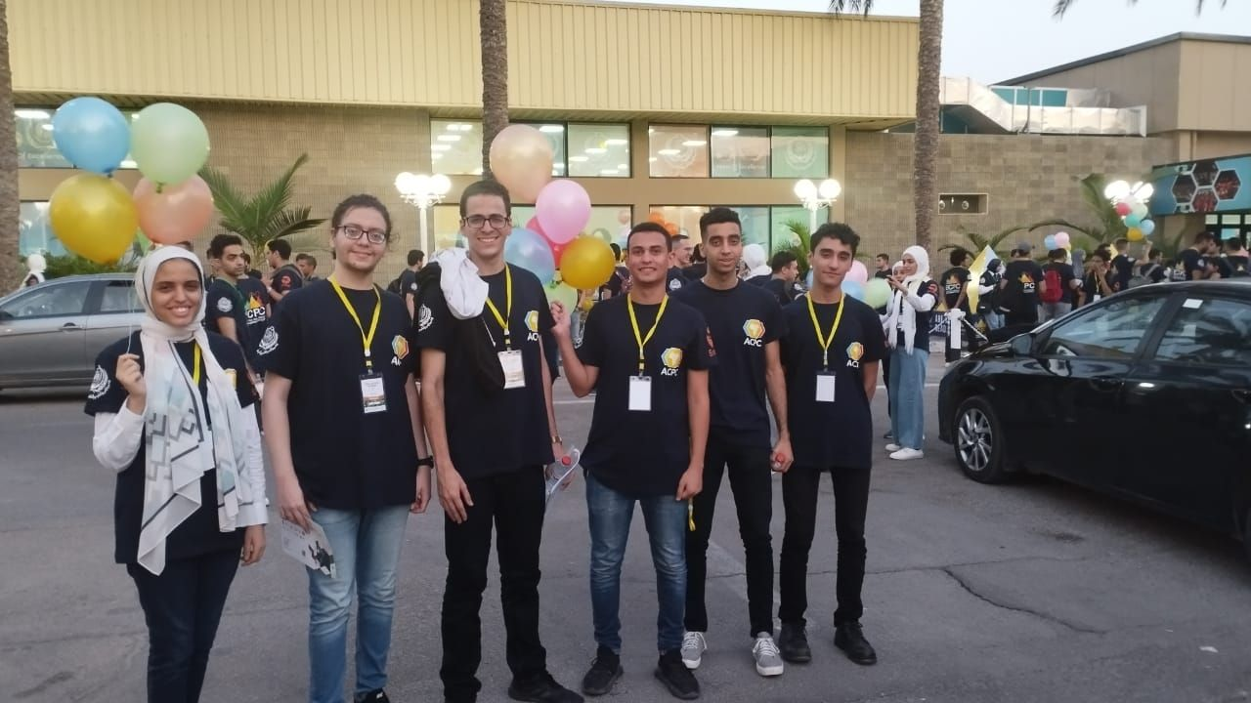


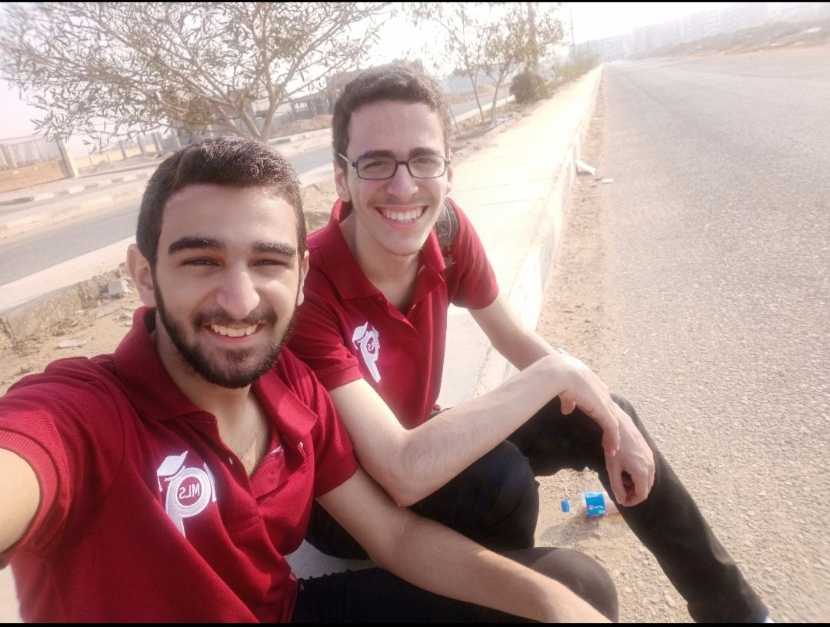




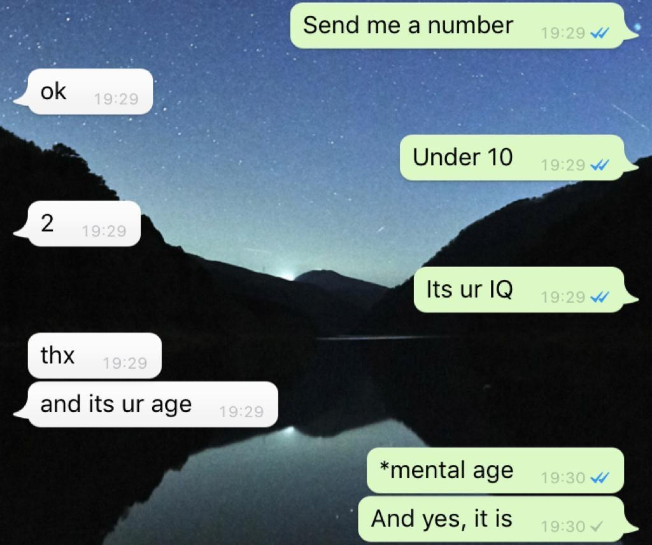
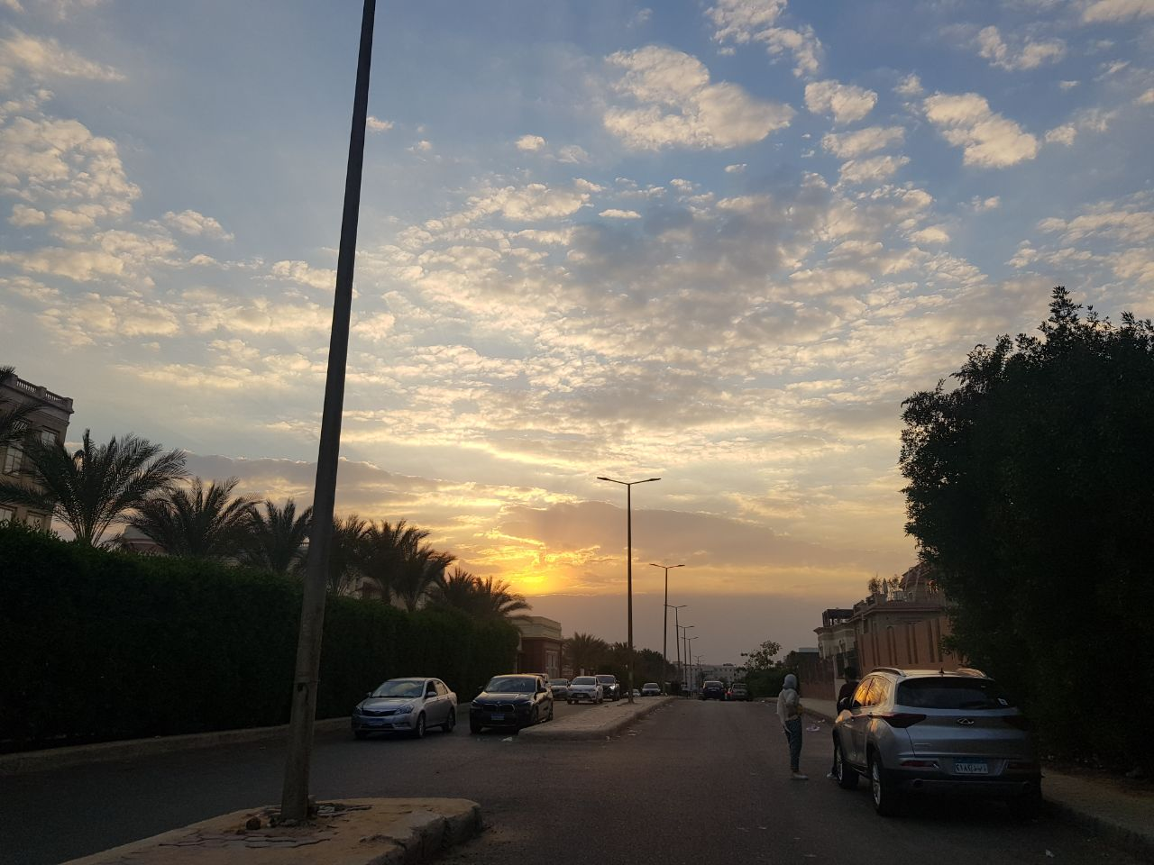
Problem?
Personal Images
(PIs)
Irrelevant Images
(IRIs)

Slide 3

Solution?
Egyptian Personal Images Classifier
A and/or Method of Automating PIs & IRIs Classification
DL
ML

Slide 4



Methodologies
Dataset Preparation Phase
Model Evaluation Phase
Model Development Phase

Slide 5
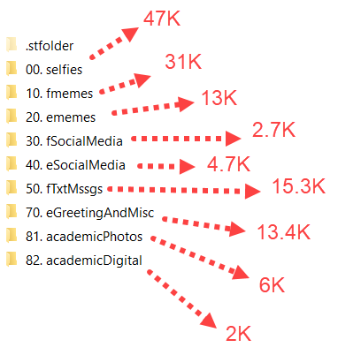
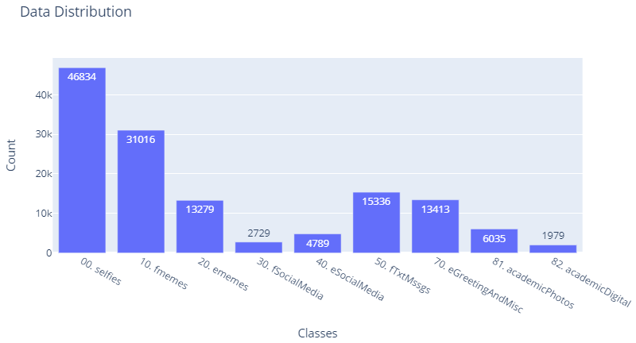
Dataset Preparation Phase
Dataset Class Distribution

Slide 6
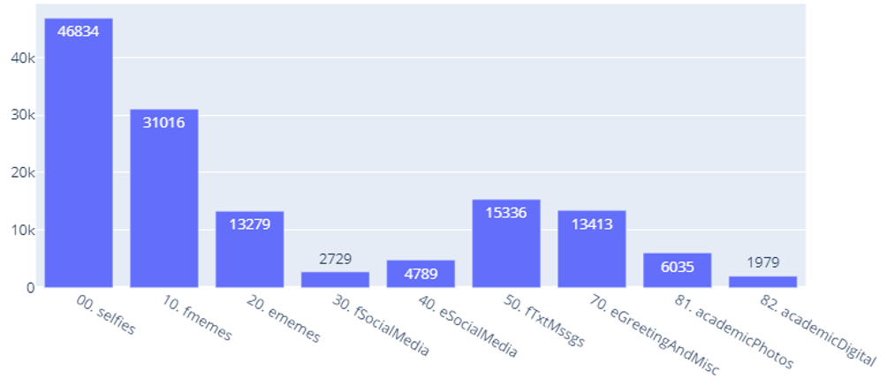
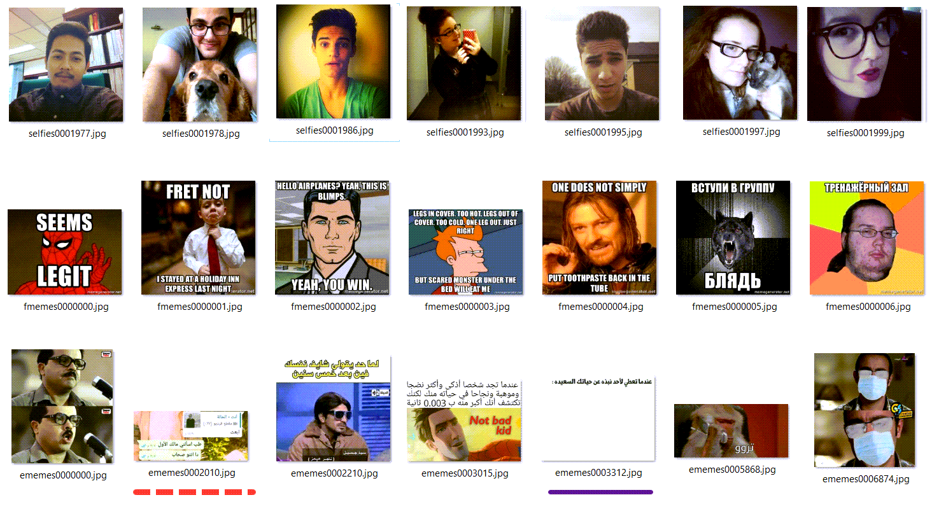

Dataset Preparation Phase
Dataset Class Samples
The Only
Benchmark Data
Remaining Classes are Scraped

Slide 7
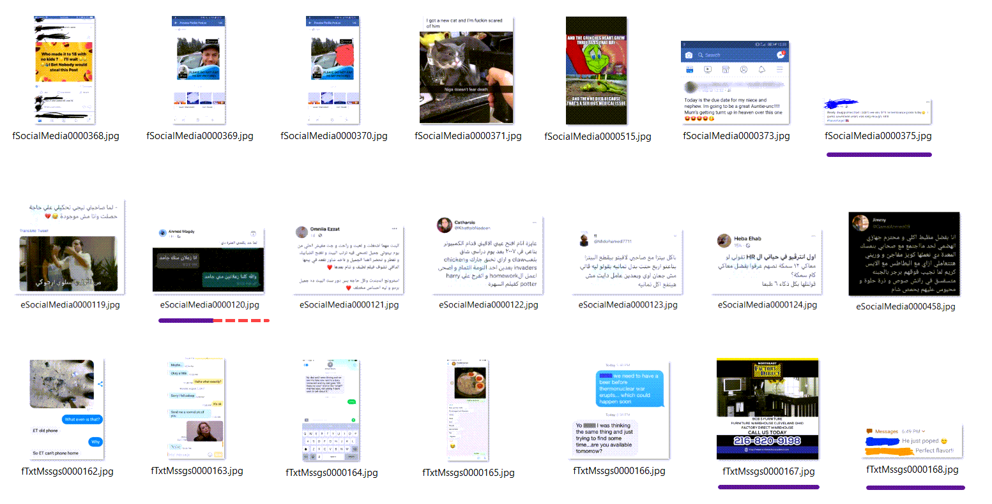
Dataset Preparation Phase
Dataset Class Samples

Slide 8
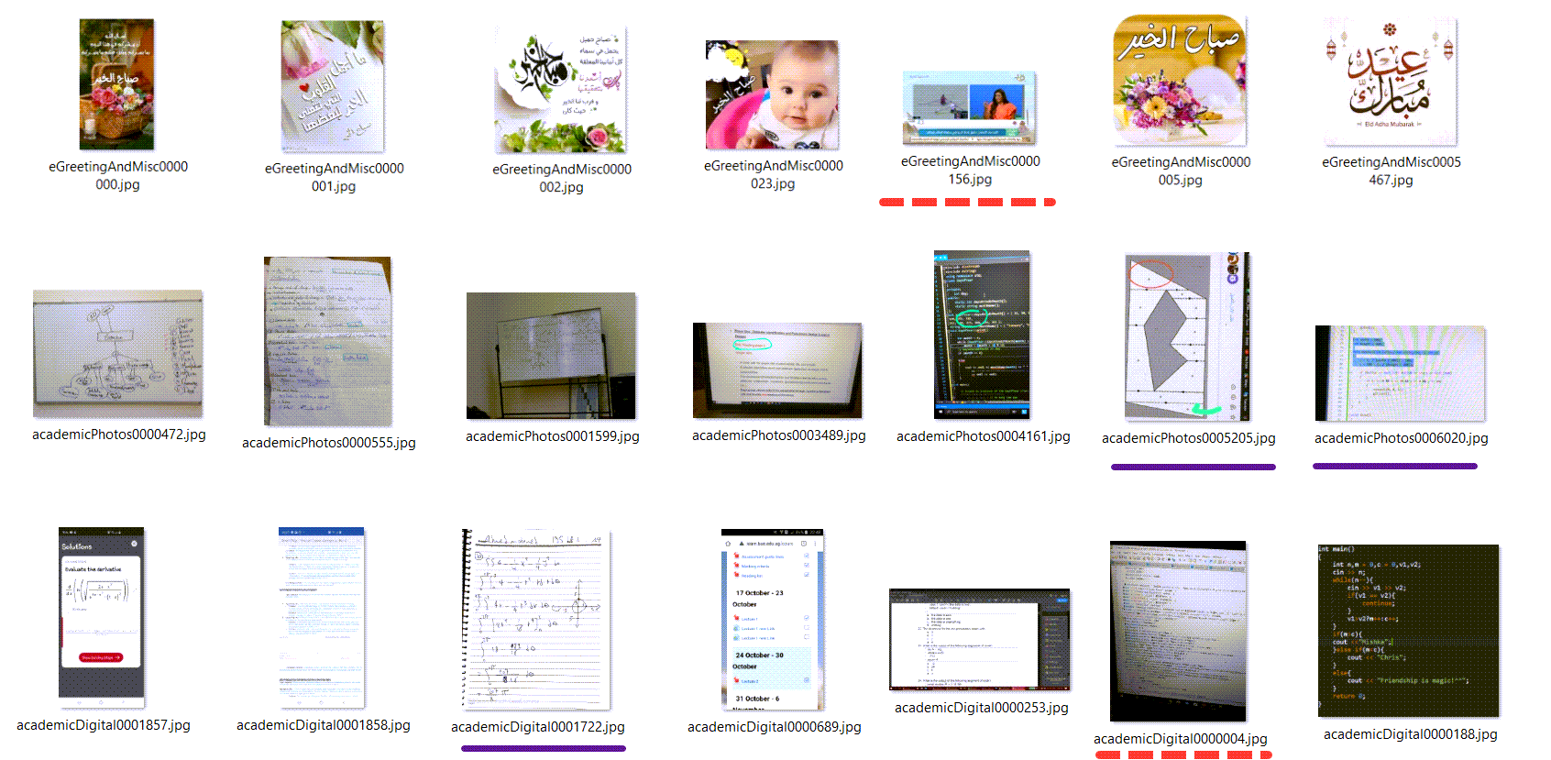
Dataset Preparation Phase
Dataset Class Samples

Slide 9
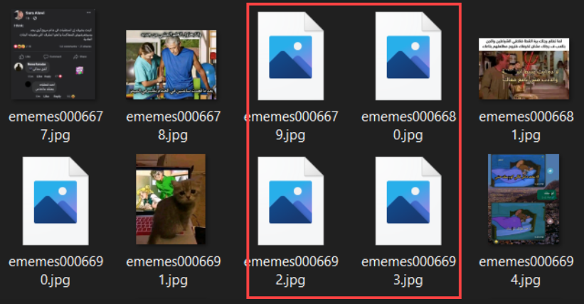
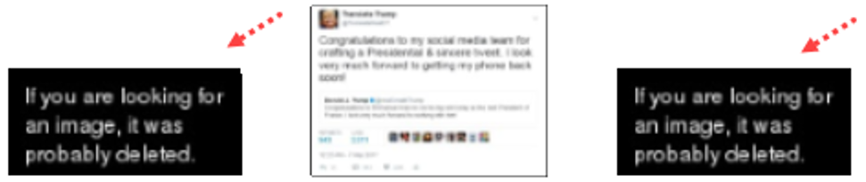
Dataset Preparation Phase
Dataset Cleaning
Removing Corrupt Images
Removing Images
Downloaded from Dead Links

Slide 10
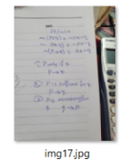
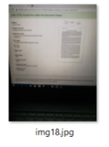
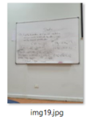
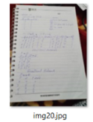
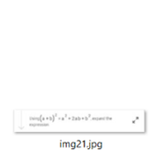
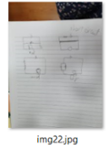

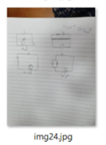
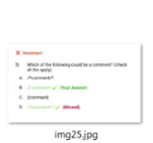
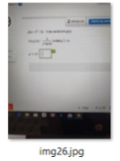
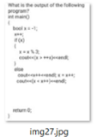
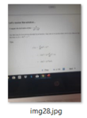
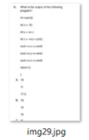
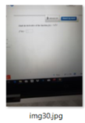
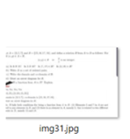
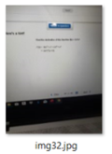
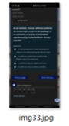
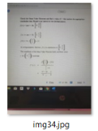
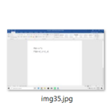
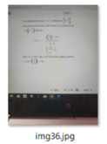
Dataset Preparation Phase
Dataset Cleaning
“academicPhotos” (contains “academicDigital” which should be removed)
Choose class
Assign value for each image
Sort images based on their values
Rename sorted images in class directory
Manually remove unwanted images
Rename images to original names
Pipeline for Removing Misclassified/Outlier labels from a Chosen Class:

Slide 11
Dataset Preparation Phase
Dataset Cleaning
Choose class
Assign value for each image
Sort images based on their values
Rename sorted images in class directory
Manually remove unwanted images
Rename images to original names
based on metrics like highest ratio, #text boxes, etc
Pipeline for Removing Misclassified/Outlier labels from a Chosen Class:

Slide 12
Dataset Preparation Phase
Dataset Cleaning
Choose class
Assign value for each image
Sort images based on their values
Rename sorted images in class directory
Manually remove unwanted images
Rename images to original names
Pipeline for Removing Misclassified/Outlier labels from a Chosen Class:

Slide 13
Dataset Preparation Phase
Dataset Cleaning
Choose class
Assign value for each image
Sort images based on their values
Rename sorted images in class directory
Manually remove unwanted images
Rename images to original names
Pipeline for Removing Misclassified/Outlier labels from a Chosen Class:

Slide 14
Dataset Preparation Phase
Dataset Cleaning
Choose class
Assign value for each image
Sort images based on their values
Rename sorted images in class directory
Manually remove unwanted images
Rename images to original names
Pipeline for Removing Misclassified/Outlier labels from a Chosen Class:
0000_img29
...
0007_img35
0008_img17
0028_img36

Slide 15
Dataset Preparation Phase
Dataset Cleaning
Choose class
Assign value for each image
Sort images based on their values
Rename sorted images in class directory
Manually remove unwanted images
Rename images to original names
Pipeline for Removing Misclassified/Outlier labels from a Chosen Class:
move them to another folder or delete them
0008_img17
0028_img36

Slide 16
Dataset Preparation Phase
Dataset Cleaning
Choose class
Assign value for each image
Sort images based on their values
Rename sorted images in class directory
Manually remove unwanted images
Rename images to original names
Pipeline for Removing Misclassified/Outlier labels from a Chosen Class:
move them to another folder or delete them
0008_img17
0028_img36

Slide 17
Dataset Preparation Phase
Dataset Cleaning
Choose class
Assign value for each image
Sort images based on their values
Rename sorted images in class directory
Manually remove unwanted images
Rename images to original names
Pipeline for Removing Misclassified/Outlier labels from a Chosen Class:
img17
img36

Slide 18

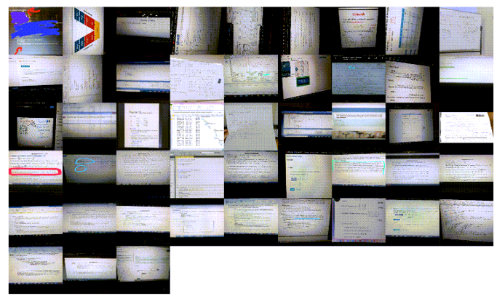
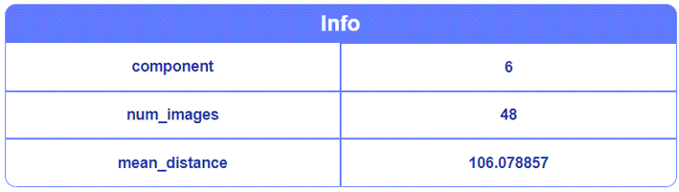
Dataset Preparation Phase
Dataset Cleaning
Removing Outlier Clusters
Example:
“academicDigital” images
which should actually be in “academicPhotos”
(Generated from KNN with #clusters = 20)

Slide 19
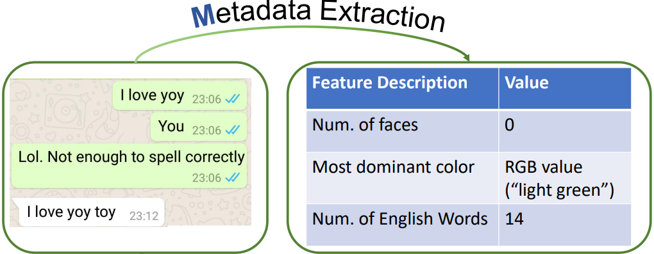
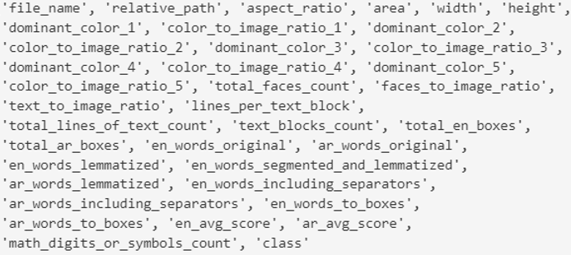
Dataset Preparation Phase
Dataset Preprocessing
List of Features (i.e., Metadata) Extracted per Image
Image’s Metadata Example:
up next:
Model Development Phase

Slide 20

Model Development Phase

Slide 21
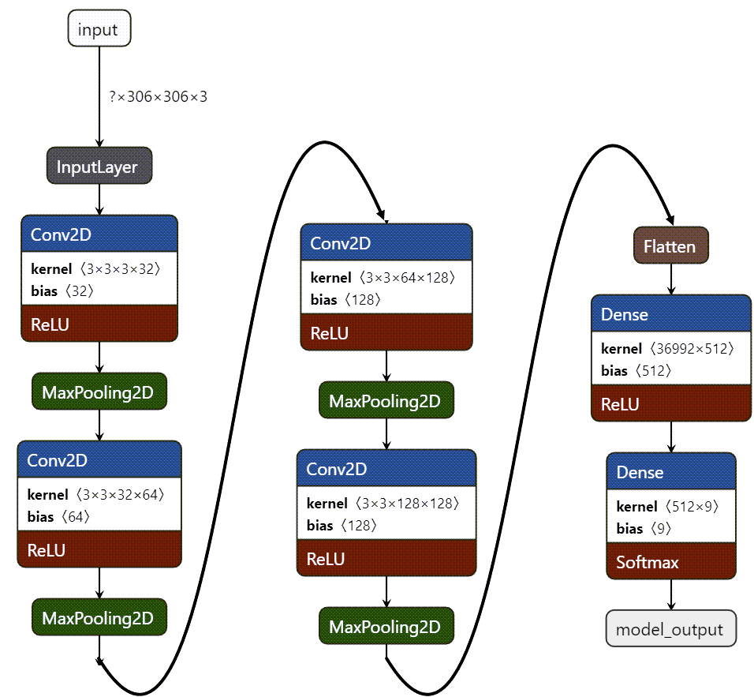
Model Development Phase
Architectures Used
VCNN
base
“m01”

Slide 22
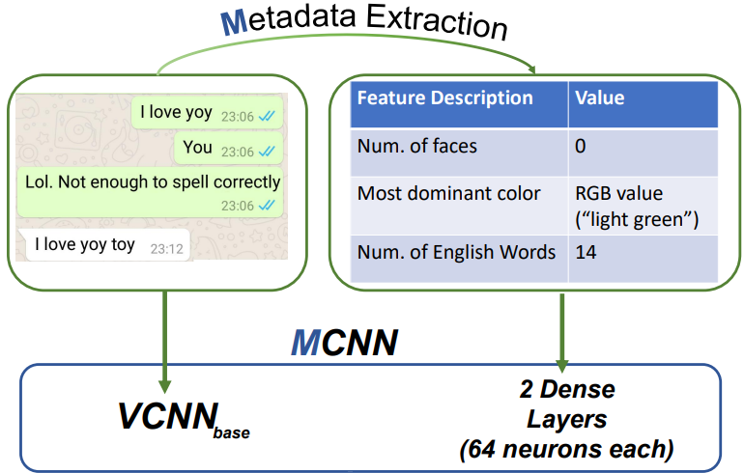
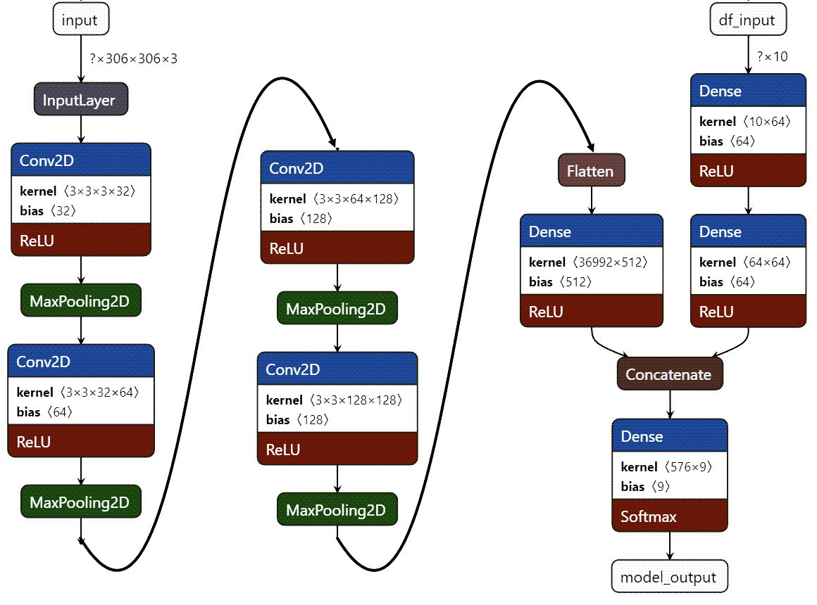
Model Development Phase
Architectures Used
VCNN
MCNN
base
“m02”

Slide 23
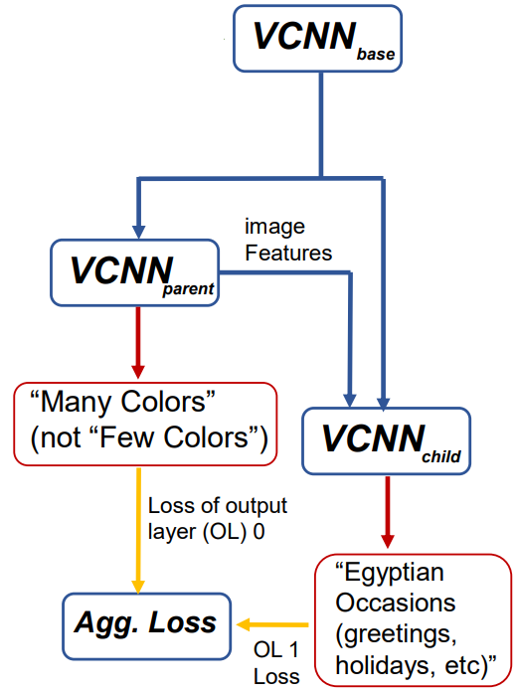
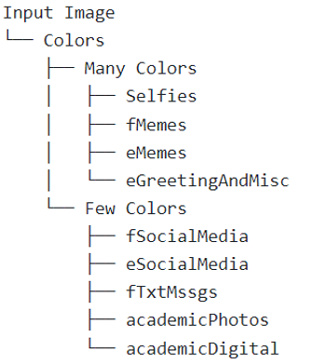
Model Development Phase
Architectures Used
HCNN
“m03”
Output Layer 0:
Many or Few Colors
classification of OL 0
Output Layer 1:
Flat classes
(i.e., the 9 classes of the dataset)
classification of OL 1

Slide 24
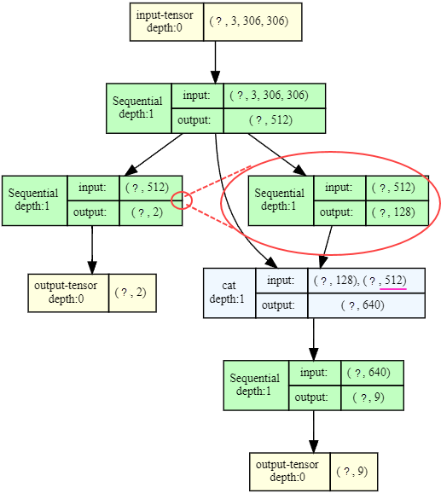
Model Development Phase
Architectures Used
HCNN
“m03”

Slide 25
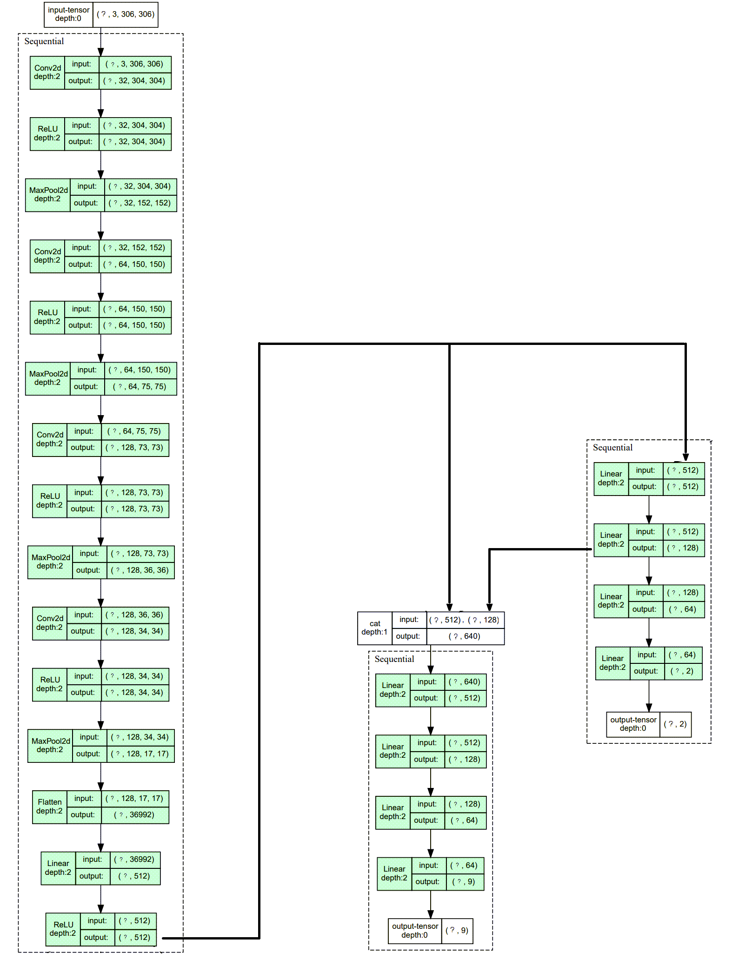
VCNN
Model Development Phase
base
Architectures Used
HCNN
“m03”
VCNN
base
VCNN
parent
VCNN
parent
VCNN
child
VCNN
child

Slide 26
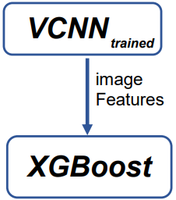
Model Development Phase
Architectures Used
VCNN
trained
XCNN
“m04”
up next:
Model Evaluation Phase

Slide 27

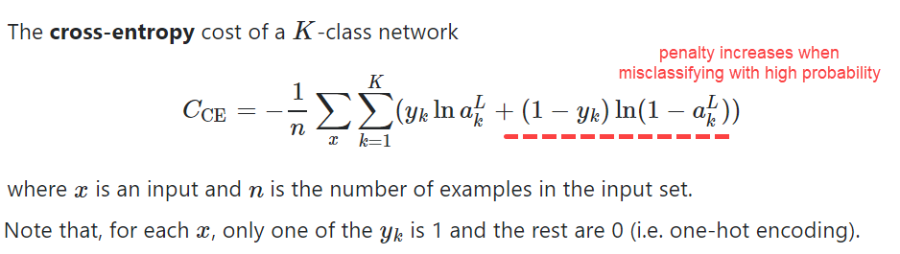

Model Evaluation Phase
Objective Functions
Used on
VCNN,
MCNN,
HCN
Used on
XCNN

Slide 28
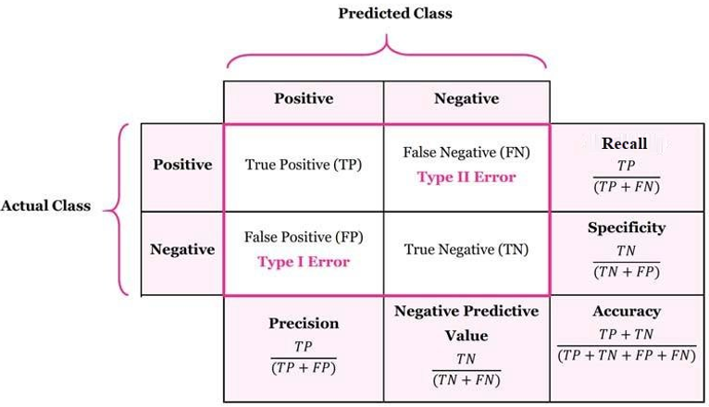
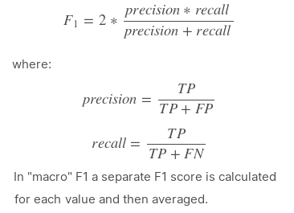




Model Evaluation Phase
Evaluation Metrics
However, only 3 and 4 are mentioned in Results Section due to their Importance on Imbalanced Datasets
up next: Implementation

Slide 29
Implementation
Important Remarks on
Hyperparameters Used
for Model Variants
Dataset Preparation

Slide 30


Implementation
Dataset Preparation
(extracting face and text metadata)
“RetinaFace”
output
“PaddleOCR”
output

Slide 31


Implementation
Hyperparameters & Descriptions of Model Variants
Initial Learning Rate: 0.001
Adam Optimizer with
$β_{1}=0.9$, and $β_{2}$=0.999
Learning Rate: 0.3
up next:
Results

Slide 32

Results
&
Analysis

Slide 33


Results
Analysis & Recommendations
F1-Score Avg.
Model Version

Slide 34
Results
Analysis & Recommendations
F1-Score Avg.
1.
↔
batch size
F1
Model Version

Slide 35
Results
Analysis & Recommendations
F1-Score Avg.
1.
↔
batch size
F1
2.
Removing outliers in Minorities
↔
F1
Model Version

Slide 36
Results
Analysis & Recommendations
F1-Score Avg.
1.
↔
batch size
F1
2.
Removing outliers in Minorities
↔
F1
3.
Normalizing input, ex.,
colour metadata
Model Version
↔
F1

Slide 37
Results
Analysis & Recommendations
F1-Score Avg.
1.
↔
batch size
F1
2.
Removing outliers in Minorities
↔
F1
3.
Normalizing input, ex.,
colour metadata
Model Version
↔
F1
4.
Sample weights,
& Bayes. opt.
↔
F1
still overfitting

Slide 38
Results
Analysis & Recommendations
F1-Score Avg.
1.
↔
batch size
F1
2.
Removing outliers in Minorities
↔
F1
3.
Normalizing input, ex.,
colour metadata
Model Version
↔
F1
4.
Sample weights,
& Bayes. opt.
↔
F1
still overfitting
5.
Easy Classification (general) then harder classification (specific)
↔
F1

Slide 39
Conclusion, Limitations, & Future Work
1. “Data-Centred” approach should be further applied due to using a custom dataset. Due to time constraints, it was difficult to keep manually cleaning images and performing extra data preparation steps
2. “Model-Centred” approach has also the disadvantage of time and computational restraints; Considerable amount of effort should go to profiling the model training process to minimize time and power consumption.
3. Outdated libraries, like RetinaFace & PaddleOCR, should be replaced to avoid dependency issues & ensure environment packages’ compatibility.
4. A basic mobile app should be developed to act as an easy interface for the user to categorize their private images.

Slide 40


